Slide 1

New York state’s COVID-19 journey - A visual story
Notes:
Hi, We are Group 3, and we are presenting a visual story of the New York state’s COVID -19 journey
Shashank Prapoorna Batchala
Radhika Bhaskara Halambi
Reshma Chowdary Marni
Yogesh Muppiri
Preethika Vuppala
Pavan Veer Ratna Katady

Slide 2
PROJECT DESCRIPTION
Explore the correlation between different COVID-19 metrics in New York State.
New York State Health Department
Statistical methods were used to analyze the data.
Six key hypothesis
Valuable insights on the impact of COVID-19
Hospitalizations, Fatalities and Vaccinations
Notes:
Our project draws from 3 comprehensive data sets sourced from the New York State health department, revealing key data on hospitalizations, fatalities, and vaccinations across age groups and counties.
Using these datasets, we've identified 6 hypotheses and explored correlations between different metrics to provide valuable insights on the pandemic's effects on the state of New York. Our visualizations offer a compelling representation of our findings, shedding light on the impact of COVID-19 in the state.

Slide 3
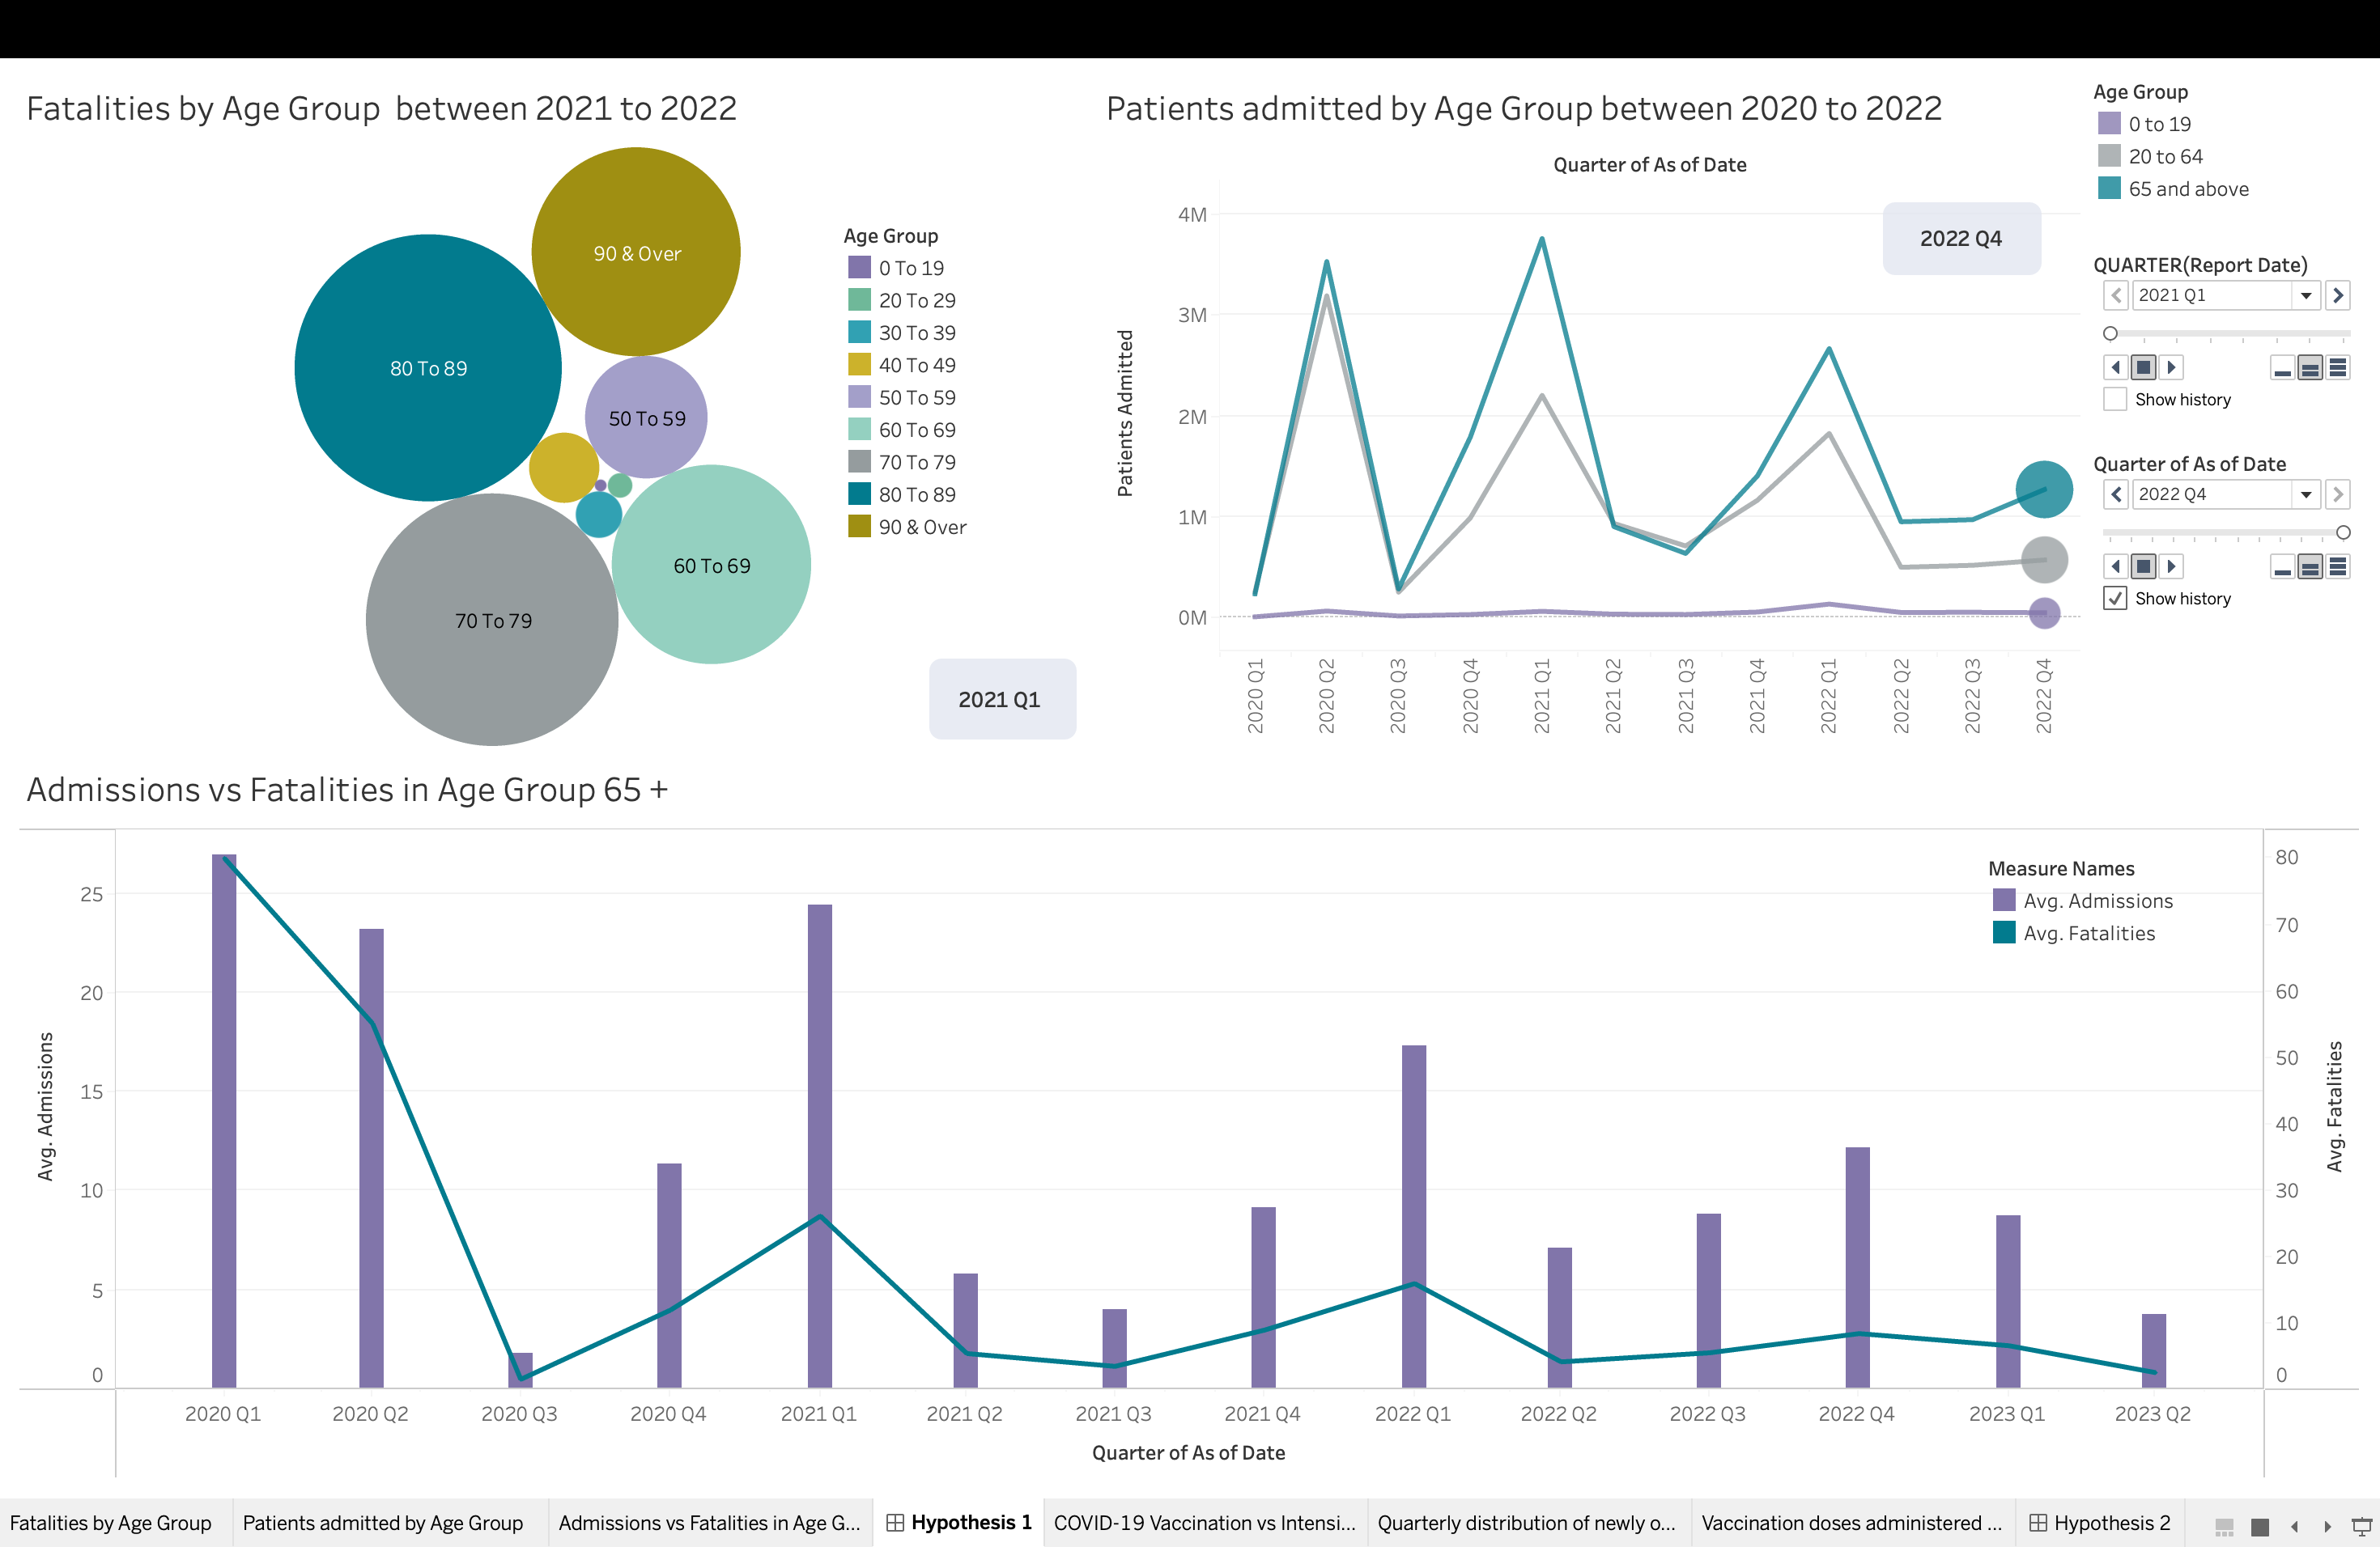
HYPOTHESIS 1
Covid patients aged 65+ are more likely to experience hospitalization and fatalities than patients in other age groups.
Conclusion: The visualizations indicate that COVID-19 patients aged 65 years and above experienced the highest rates of hospitalization and fatalities, providing empirical evidence to support the hypothesis.
Notes:
Our first hypothesis is that age is a significant factor in the impact of COVID-19.
Specifically, we posit that individuals aged 65 and over are at a higher risk for hospitalization and fatalities than those in other age groups.
To support our hypothesis, we present three graphs. The first, located on the top left, shows a packed bubble chart displaying fatalities across different demographics. As expected, the highest number of fatalities occurred in the 65+ age group.
The second graph, located on the top right, displays the hospitalization rates across age groups over a two-year period. As anticipated, the highest hospitalization rates occurred among individuals aged 65 and above.
The third graph, located on the bottom, focuses on the hospitalization versus fatality rate for individuals aged 65 and above.
Our visualizations support our hypothesis that patients aged 65 years and above are more likely to experience higher rates of hospitalization and mortality in New York due to COVID-19.

Slide 4
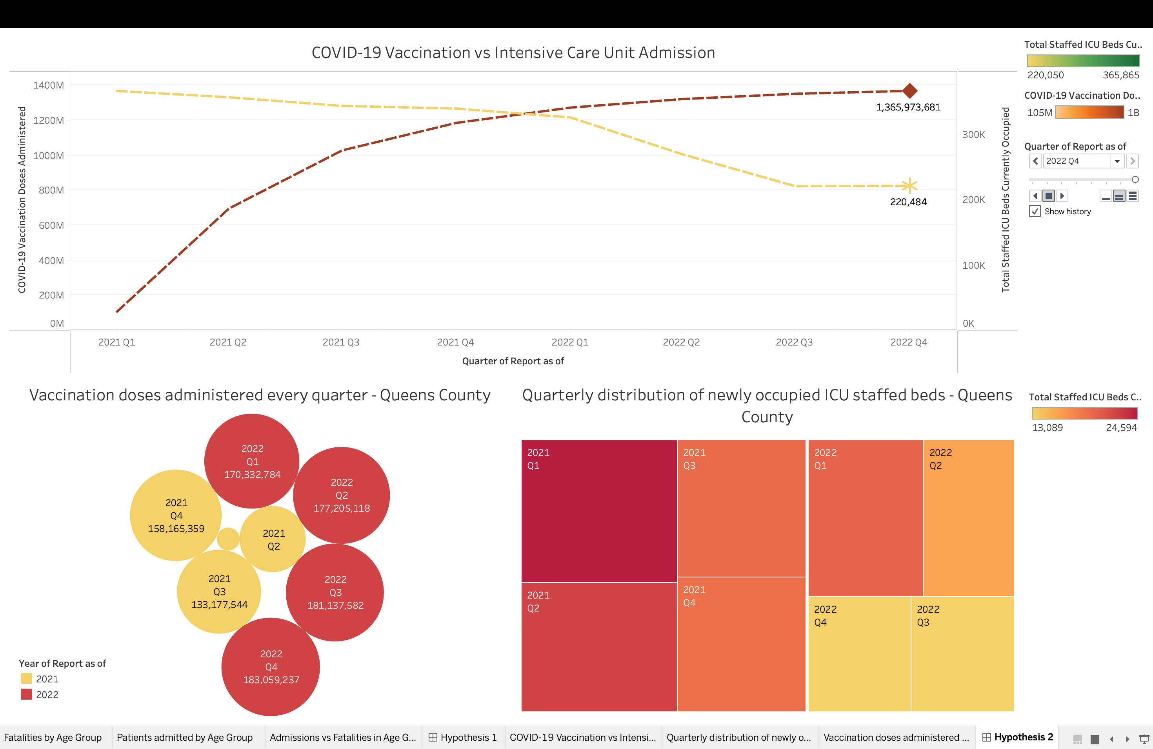
HYPOTHESIS 2
There is a correlation between the total number of COVID-19 vaccination doses administered and the number of newly occupied staffed ICU beds
Conclusion: The visualization indicates a correlation between the cumulative number of COVID-19 vaccination doses administered and the number of newly occupied staffed ICU beds in the Queens county. Specifically, areas with higher vaccination rates tend to have lower numbers of newly occupied ICU beds due to COVID-19.

Slide 5
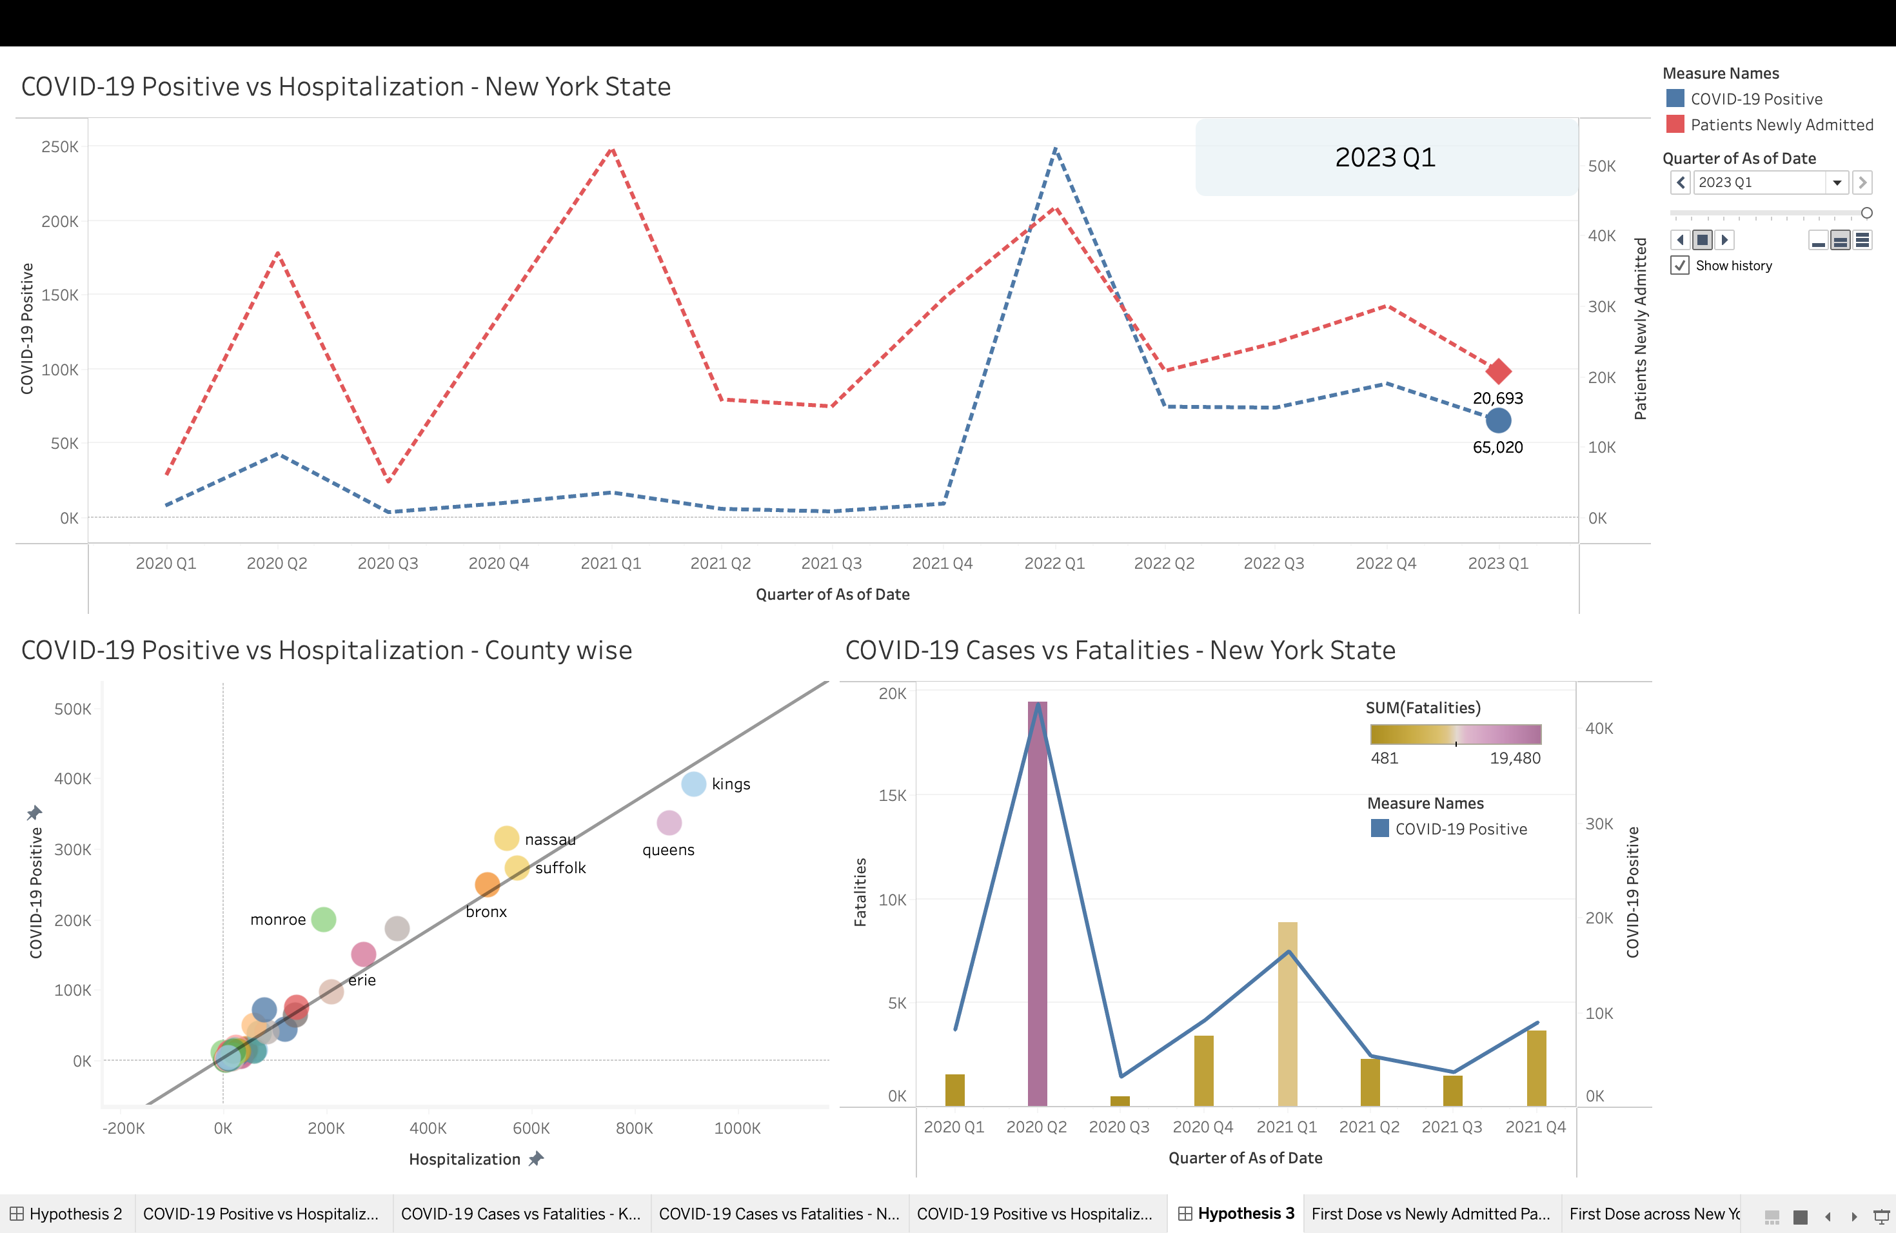
HYPOTHESIS 3
There is a positive correlation between the number of COVID-19 positive cases and the number of fatalities in a county in New York State.
Conclusion: There is indeed a positive correlation between the number of COVID-19 positive cases and the number of fatalities in a county in New York State. This implies that areas with a higher number of positive cases are more likely to experience a higher number of fatalities due to COVID-19

Slide 6
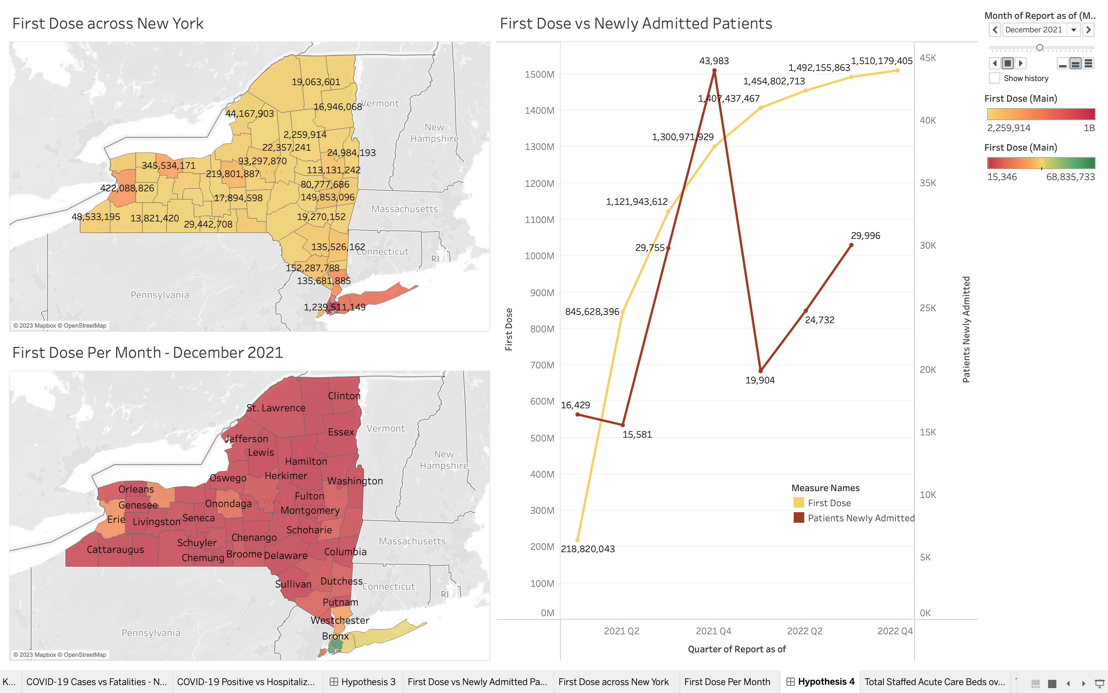
HYPOTHESIS 4
There exists a strong and significant correlation between the number of individuals who received their first dose of COVID-19 vaccination during a given quarter in a specific location and the number of newly admitted patients with COVID-19 in the subsequent quarter in the same location.
Conclusion: There is no strong and significant correlation between the number of individuals who received their first dose of COVID-19 vaccination in a specific location during a given quarter and the number of newly admitted COVID-19 patients in the same location during the subsequent quarter.

Slide 7
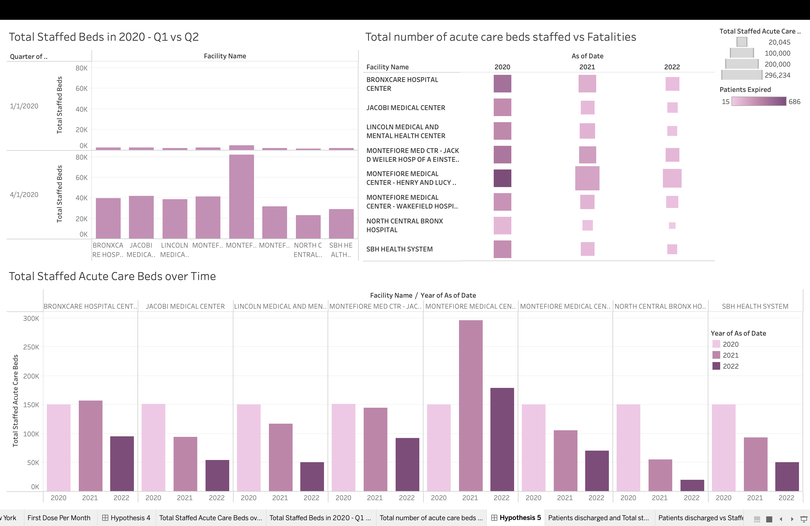
HYPOTHESIS 5
There is a relationship between the number of acute care beds staffed in a healthcare facility and the likelihood of patient mortality, such that facilities with more beds are less likely to have patients pass away than those with fewer staffed acute care beds.
Conclusion: There is no significant relationship between the number of staffed acute care beds in a healthcare facility and the likelihood of patient mortality.

Slide 8
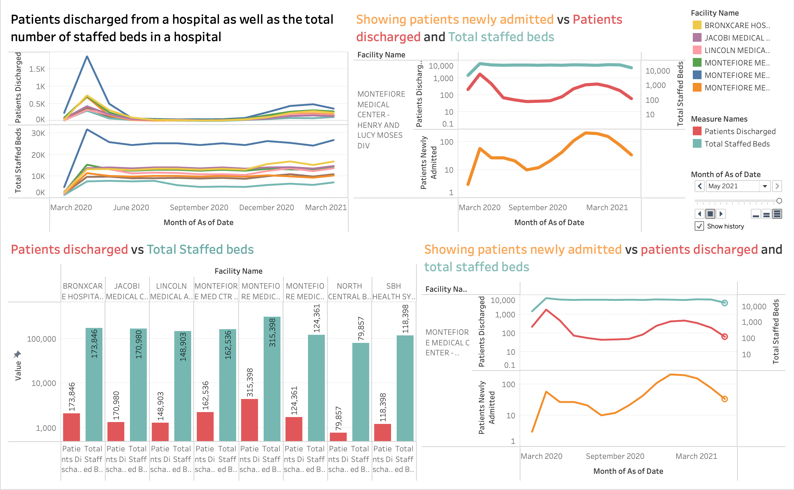
HYPOTHESIS 6
There is a significant relationship between the number of staffed acute care beds in a healthcare facility and the number of patient discharges
Conclusion: There is a significant relationship between the number of staffed acute care beds in a healthcare facility and the number of patient discharges. The analysis suggests that facilities with more staffed beds can discharge more patients compared to those with fewer staffed beds, potentially due to their higher capacity to provide care.

